Slide 1
Growing a Cutting Garden
Kate Lockwood
Dancing Beetle Flower Farm

Slide 2
Cutting Gardens
Are there for you to enjoy!
Set aside some space in your garden for growing seasonal blooms that when cut can be used in table arrangements or your own bouquets

Slide 3
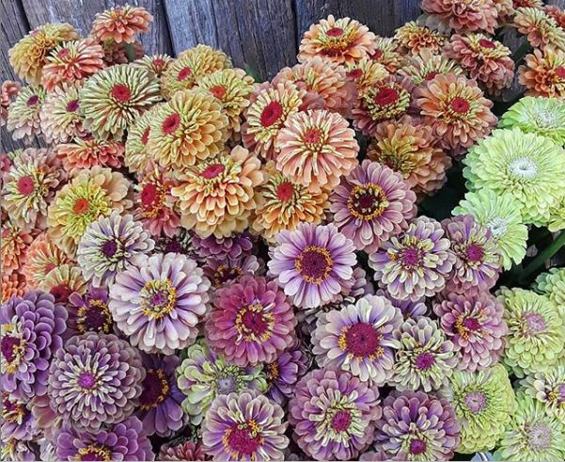
Our Farm
Dancing Beetle Flower Farm
Located in El Dorado
Managed organically
Specialize in seasonal cut flowers for florists and events
Grow over 80 varieties of cut flowers on 1 acre
Bouquets, dried flowers and crafts

Slide 4
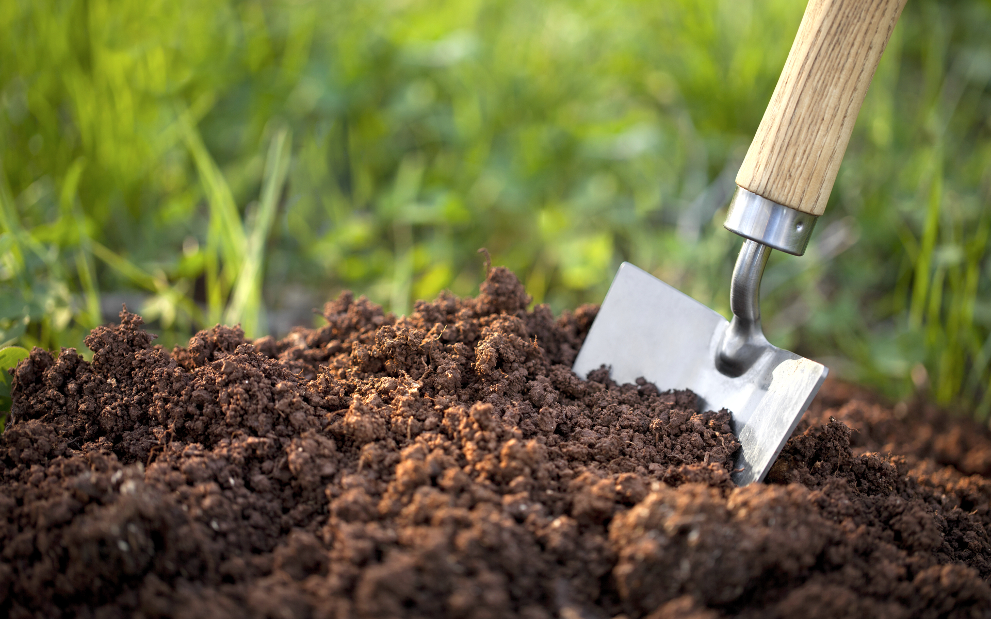
Soil Preparation for a Cutting Garden
Our soils are typically lacking in organic matter, nitrogen and calcium
Heavy clay soils with a low pH
Mitigate by:
Soil testing (A&L Labs West)
Adding organic matter (compost and cover crops)
Using an all purpose slow release fertilizer (incorporate) and foliar fertilizer later in the season
Adding gypsum (calcium sulfate) and lime (oyster shell or Dolomite)
Be careful about working your soil too early

Slide 5
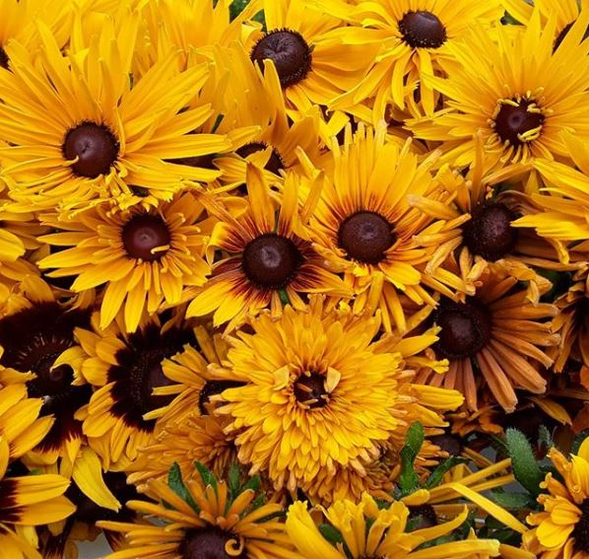
Selecting Flowers for Your Cutting Garden
Start your own seeds
Sow successions (Zinnias, Sunflower)
Select varieties that grow well in your area
Choose varieties that are meant for cut flower gardens
Seed Companies
Johnny’s Seeds
High Mowing
Osborne
Floret
Harris Seeds

Slide 6
Great Flowers for Beginning Cutting Gardens
Annuals
Amaranth Snapdragon
Bells of Ireland Statice
Cosmos Strawflower
Calendula Sunflower
Celosia Sweet Peas
Centaurea Zinnias
Cosmos
Dahlias
Gomphrena
Larkspur
Marigold
Matricaria
Nigella
Rudbeckia
Perennials and Bulbs
Anemones
Asclepias
Craspedia
Gladiolas
Echinacea
Dahlias
Hyacinth
Lavender
Narcissus
Roses
Salvia
Tulips
Verbena
Yarrow

Slide 7
Harvesting and Handling Cut Flowers
Clean, very sharp shears
Cut stems at a 45 degree angle
Cut early, not in the heat of the day
The first cut in branching varieties will be shorter than the rest
“Pinching” the center stem of branching varieties (Cosmos, Amaranth, Zinnias, Marigolds, Snapdragons, Rudbeckia) will encourage longer stems
Keep cutting. Encourage new blooms by continually cutting and deadheading old blooms.
Arrange in fresh, warm (not hot) water. Cold water causes constriction of the tissues and the flowers do not hydrate.
Do not add “flower food”, pennies, bleach, asprin etc. to the water. None of them really work. Just keep the water clean and give a fresh cut
Keep out of extreme hot or cold and out of direct sunlight

Slide 8
Great Flowers for Drying
Amaranth Statice
Ammobium Strawflower
Bells of Ireland Yarrow
Celosia
Craspedia
Corn - decorative
Dusty Miller
Eucalyptus
Feverfew/Matricaria
Grasses
Gomphrena/Globe Amaranth
Larkspur
Lavender
Lunaria
Nigella
Poppy Pods
Scabiosa
You can try drying almost any flower. Quality will vary from flower to flower. Most flowers that have a lot of moisture, won’t dry well or hold their shape.
Methods
*Hang drying
*Pressing
*Silica sand
*Glycerin

Slide 9
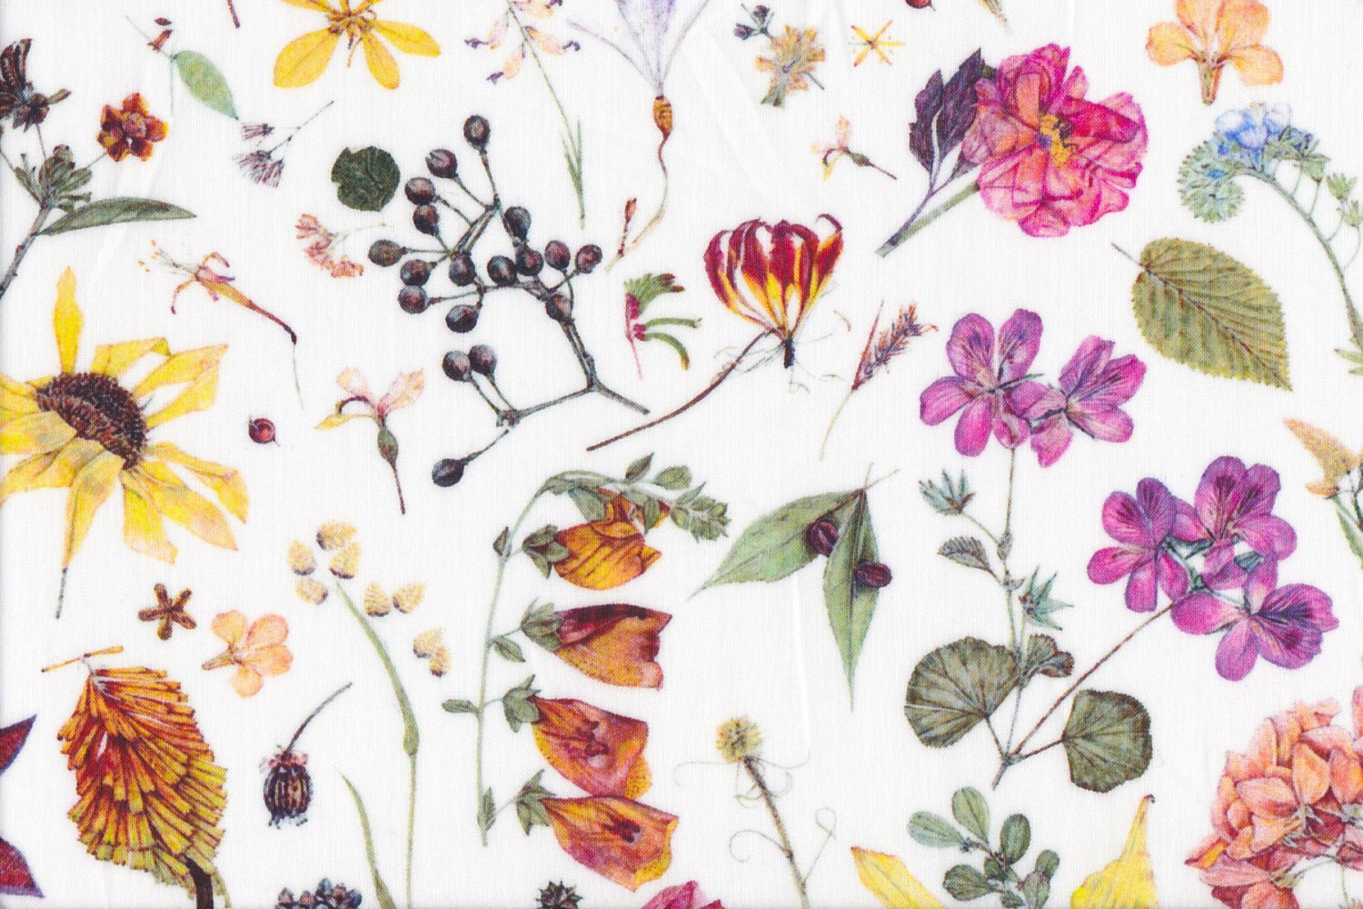
Dried Flower Care
*Keep out of direct sunlight
*Do not place in water
*A spray of aerosol craft glue or even hair spray can help fragile flowers from shattering
*Can be used for many craft projects
*Can be enjoyed for years with proper care

Slide 10
Kate Lockwood
Dancing Beetle Flower Farm
dancingbeetlefarm@gmail.com
Find us on Facebook and Instagram

